Slide 1
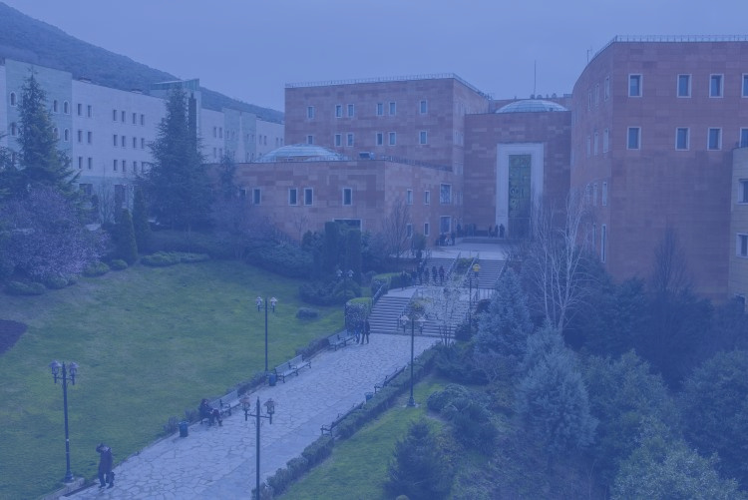



Yeditepe University
Faculty of Fine Arts
Network Infrastructure and Performance Analysis
NAZ CAMİŞ
BAYRAM BEŞER
OSMAN UĞUR TAŞ
DENİZ BERFİN YAĞIZ
ESAT CAN KARABAĞ

Slide 2

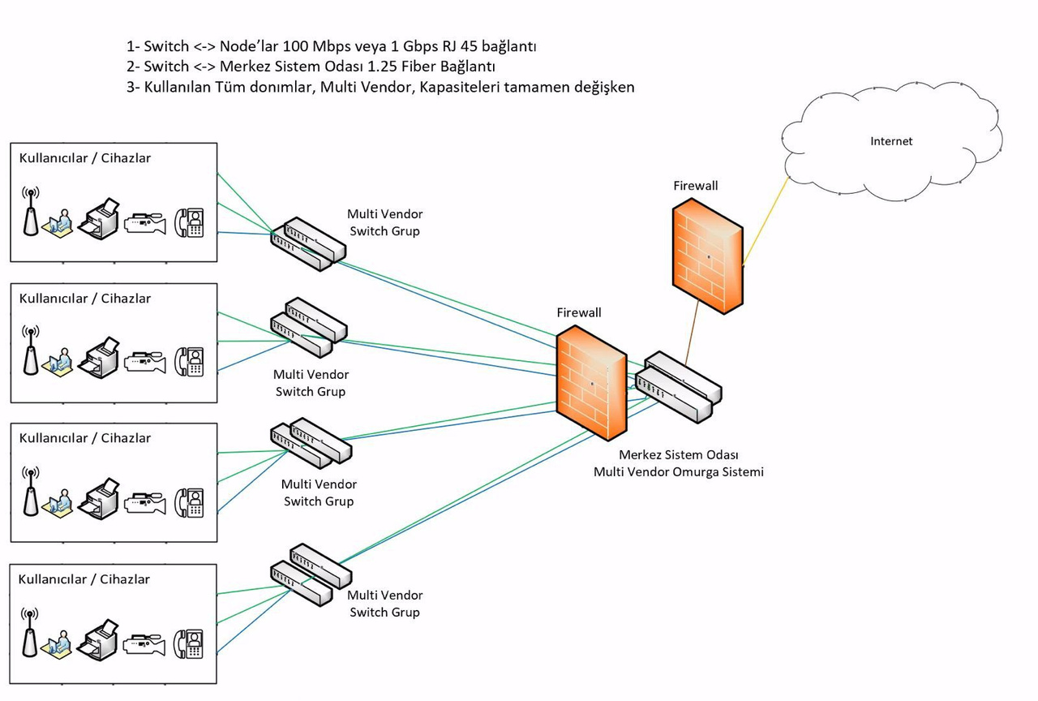
Bandwidth and Distribution
The internet infrastructure at our university is distributed from the central system room to all faculties. The connection details are as follows:
User Connections (Switch <-> Nodes):
Connection Type: Ethernet (RJ45)
Speed: 100 Mbps or 1 Gbps
Connection to the Central System Room (Switch <-> Central System Room):
Connection Type: Fiber Optic
Speed: 1.25 Gbps
Figure 1: Connection Diagram of Our University's Internet Infrastructure

Slide 3
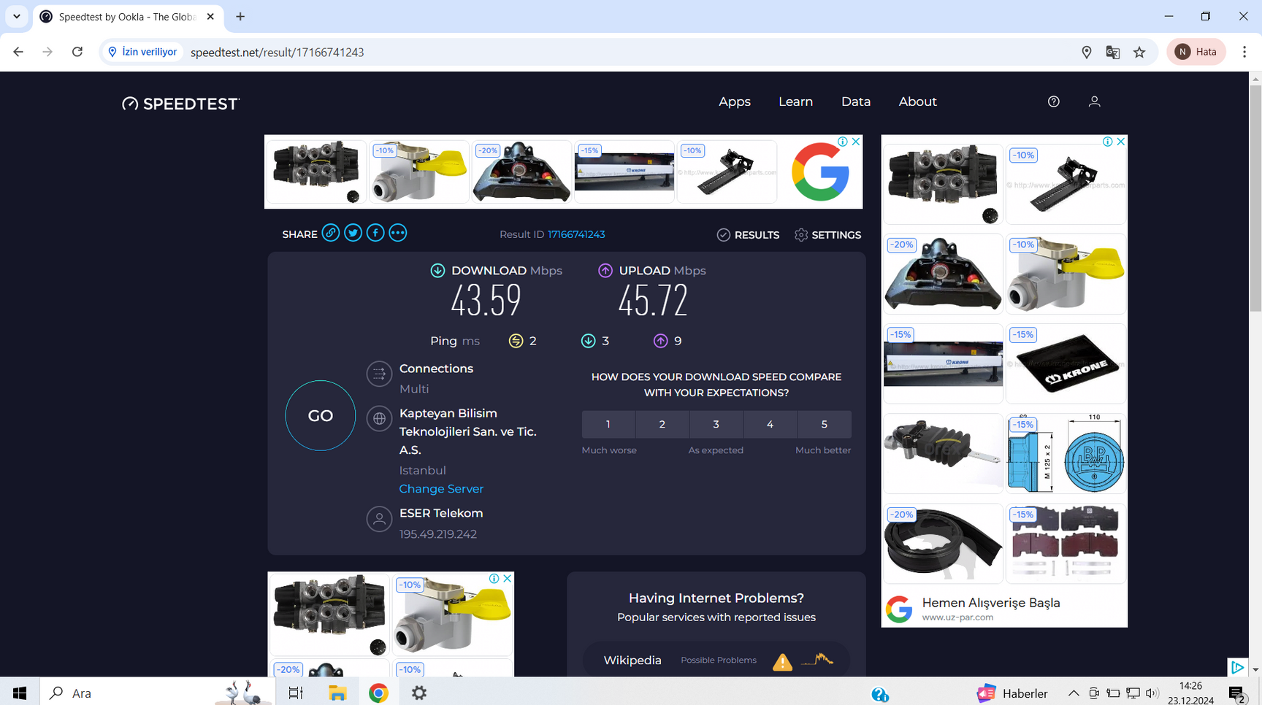
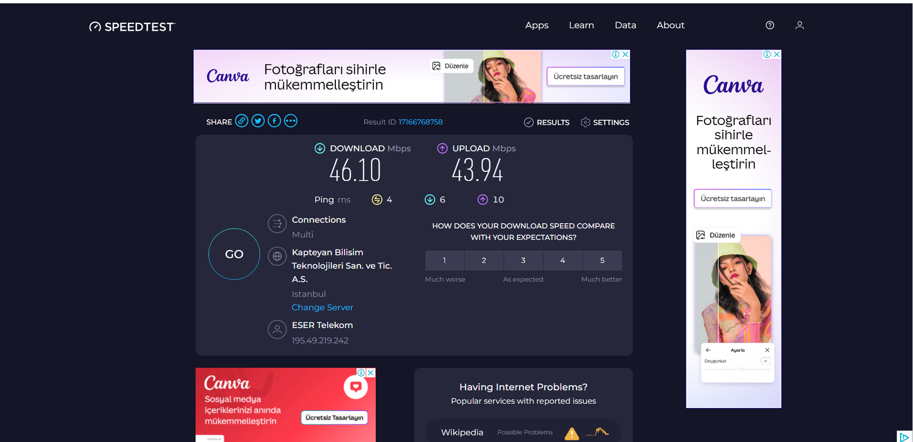
Bandwidth and Distribution
The internet connection for the Faculty of Fine Arts is provided through two separate system rooms in the building. The system room on the 4th floor distributes internet to floors 0-5, while the system room on the 6th floor serves floors 6-8. The internet is delivered to the building via fiber optic cable, but distribution to the floors within the building is carried out using copper cables (Ethernet).
In both system rooms, connections are managed through switches. According to the speed tests we conducted, the internet speed allocated to the building was measured to be approximately 50 Mbps in both system rooms. This speed is shared among users throughout the faculty.
Figure 2: Results of the Speed Tests Conducted in the Faculty of Fine Arts

Slide 4
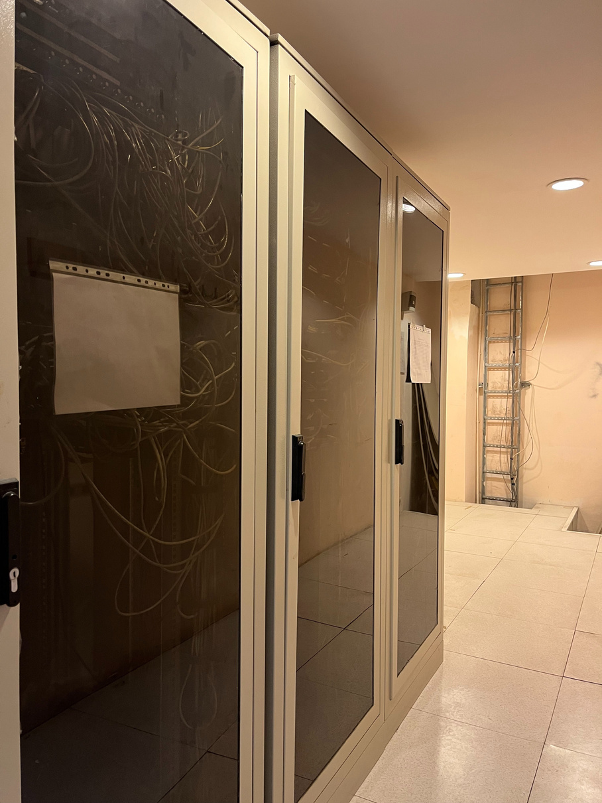
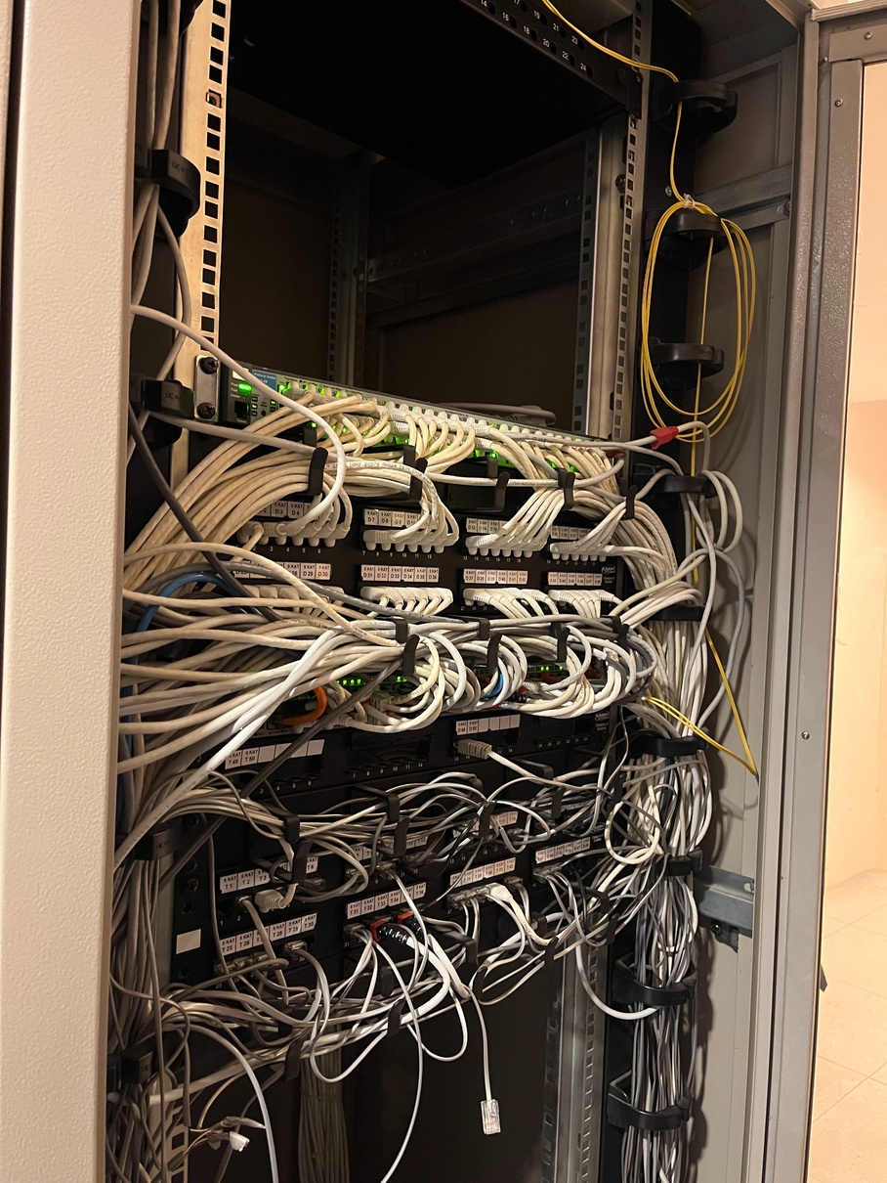
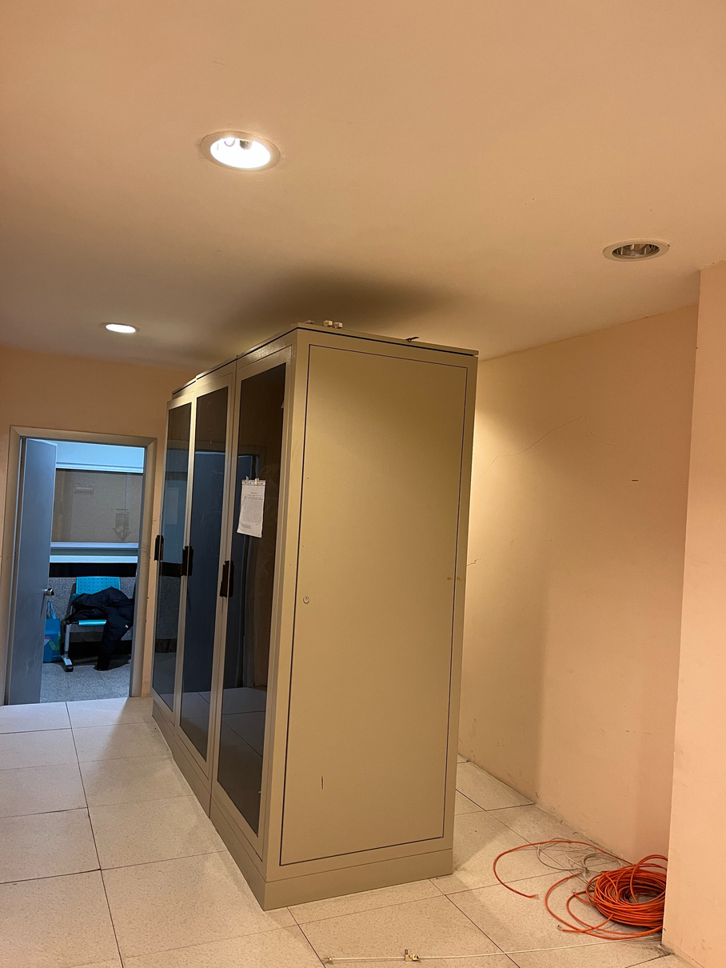
Bandwidth and Distribution
Figure 3: Photos of the System Rooms on the 4th and 6th Floors in the Faculty of Fine Arts.

Slide 5
Is the Current Connection Method Cost-Effective?
Fiber optic provides high speed and low latency, but Ethernet cabling inside the building limits its full potential. While the current setup is a balanced solution, Ethernet distribution creates a bottleneck, and alternative solutions could be explored.
• More Suitable Alternatives:
• FTTR: Expanding fiber inside the building ensures high speed but comes with high installation costs.
• Wireless Systems (Wi-Fi 6/Mesh): Cost-effective, especially for high-traffic areas.
• PoE Technology: Utilizes Ethernet cables for both power and data, offering cost savings and easy installation.
Notes:
1. Is the Current Connection Method Cost-Effective?
Fiber optic provides high speed and low latency, but Ethernet cabling inside the building limits its full potential. While the current setup is a balanced solution, Ethernet distribution creates a bottleneck, and alternative solutions could be explored.
2. More Suitable Alternatives:
• FTTR: Expanding fiber inside the building ensures high speed but comes with high installation costs.
• Wireless Systems (Wi-Fi 6/Mesh): Cost-effective, especially for high-traffic areas.
• PoE Technology: Utilizes Ethernet cables for both power and data, offering cost savings and easy installation.

Slide 6
Improvement Suggestions
Increasing the Internet Speed Allocated to the Faculty
The speed allocated to the building (50 Mbps) appears insufficient as it is shared among all faculty users.
Discussions with university administration could ensure higher speed allocation for the faculty.
Expanding Wireless Internet Coverage
Wi-Fi 6 or Mesh technology can be used to cover corridors, classrooms, and other common areas.
More access points should be installed in high-traffic areas.
Dedicated Solution for the Cafeteria
A separate internet line can be allocated for high-usage areas like the cafeteria (e.g., a dedicated switch and router from the 4th-floor system room).
Network Security and Traffic Management
Network management software can be used to optimize performance based on the number of users.
Unnecessary network traffic (e.g., video streaming or large file downloads) can be restricted.

Slide 7
Internet Access in Common Areas and User Density
In the faculty, only a specific area on the 4th floor and the cafeteria are covered by Wi-Fi. However, this coverage is quite limited and only includes certain zones. On other floors, particularly in corridors and common areas, there is no internet access. Additionally, there is a Wi-Fi network on the 2nd floor because mobile internet does not work in that area. This network serves as a temporary solution for users in this zone with no mobile internet coverage. Aside from this, wireless internet access is not available on other floors, classrooms, or common areas in the faculty. Internet access for the computers in the classrooms is provided through Ethernet cables.

Slide 8
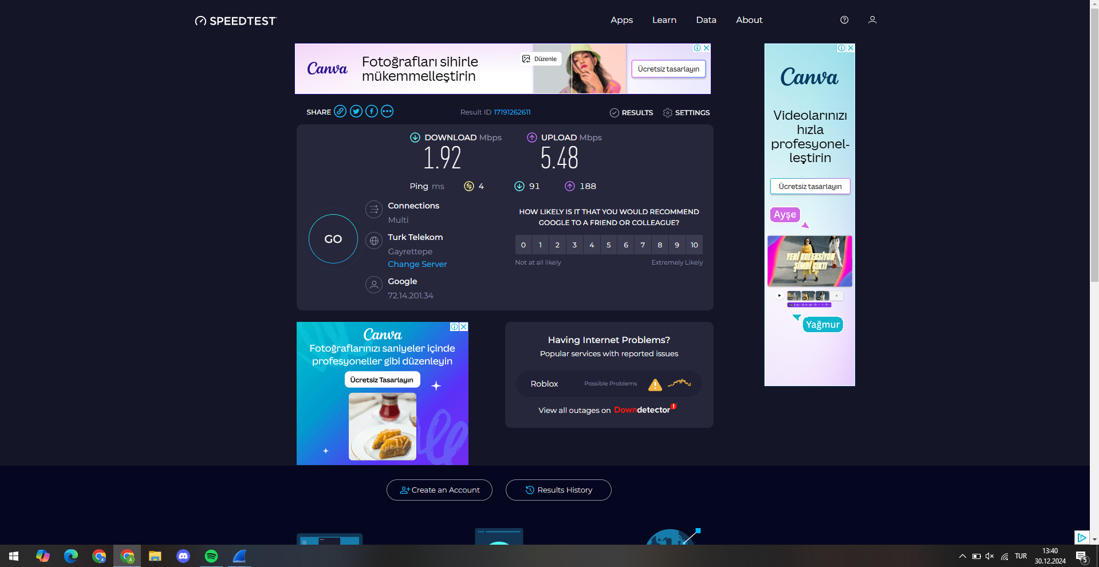
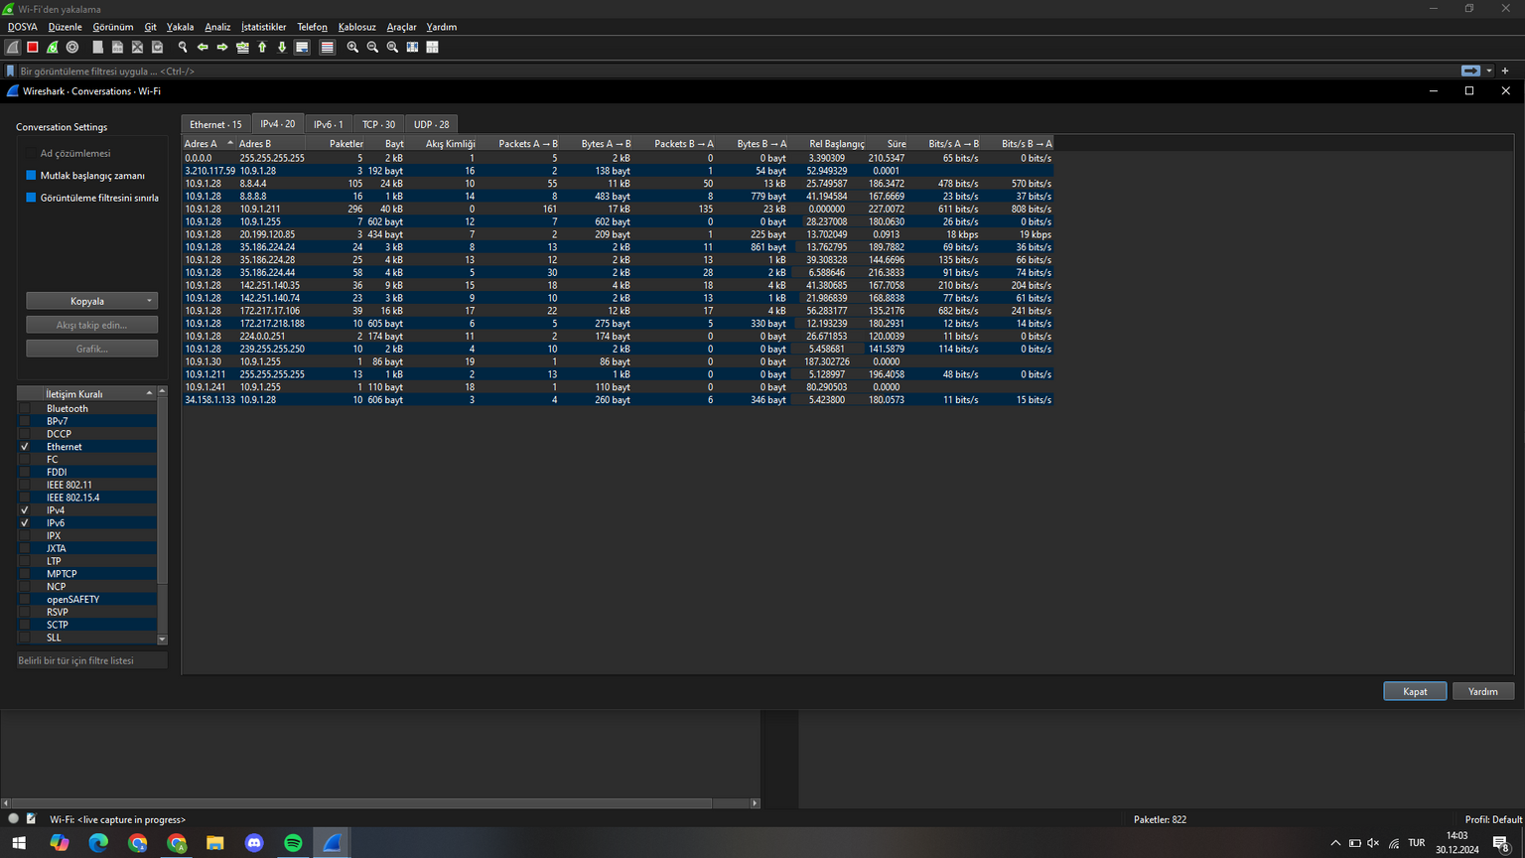
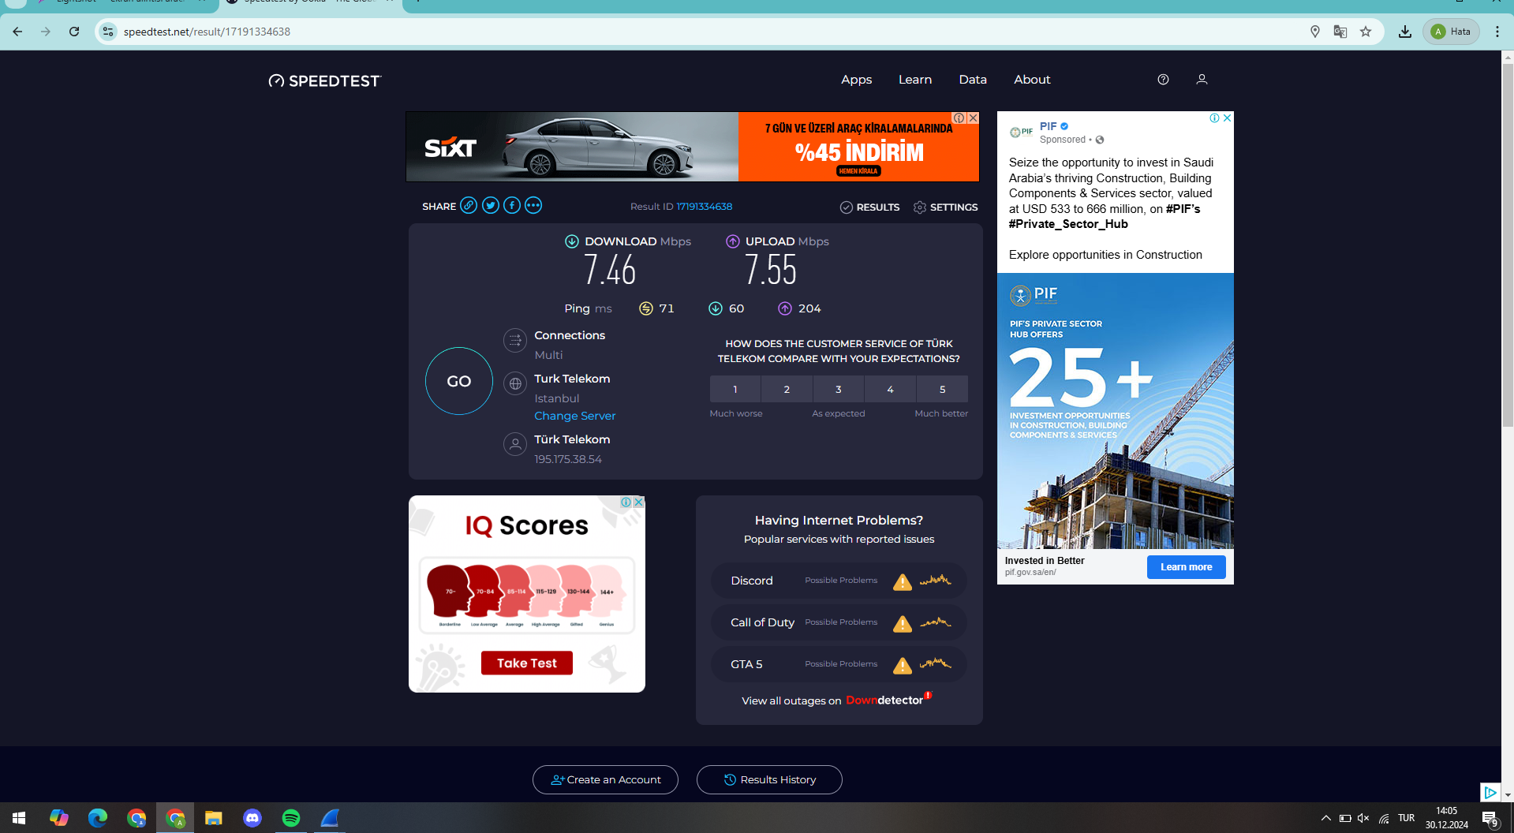
Cafeteria User Density Tests
In the cafeteria, approximately 54 people were connected to the Wi-Fi network between 12:00 PM and 2:00 PM. During these peak hours, the Speedtest results showed that the internet speed dropped to around 2 Mbps. During off-peak hours, between 2:00 PM and 4:00 PM, only 20 people were connected to the Wi-Fi network in the cafeteria, and the speed increased to about 8-9 Mbps. Using Wireshark, we analyzed and identified the number of users connected to the Wi-Fi network. This demonstrated that the network's performance varied significantly depending on the number of users.
Figure 4: Results of the Speed Tests Conducted in the Cafeteria

Slide 9
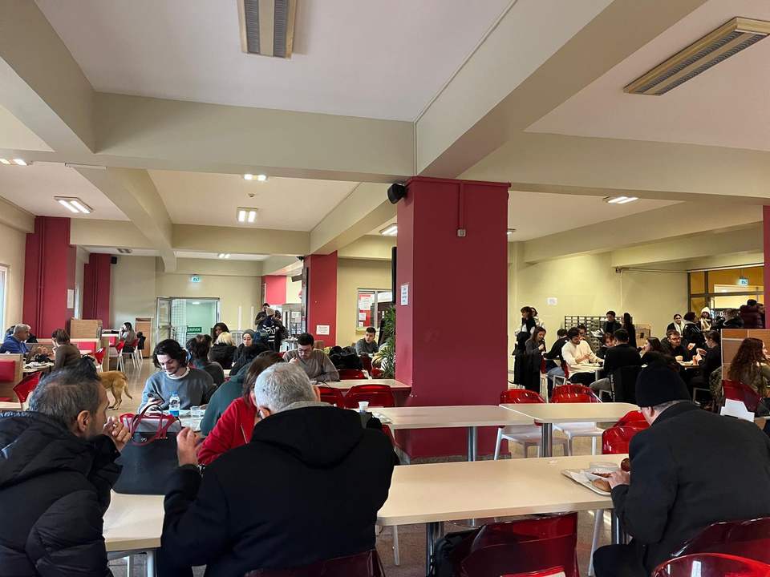
Cafeteria User Density Tests
The signal strength in the cafeteria was generally very strong. Our phones consistently showed a high signal level for the Wi-Fi connection. Therefore, there was no issue with signal strength. However, as the number of users increased, the network speed decreased, which negatively impacted the user experience.
Figure 5: Cafeteria of the Faculty of Fine Arts During Peak Hoursi

Slide 10
Is the bandwidth sufficient based on the number of users?
Bandwidth allocation for the faculty is approximately 50 Mbps, distributed among all users. Observations from the cafeteria indicate that during peak hours (12:00-14:00) with approximately 54 users connected, the internet speed drops significantly to about 2 Mbps. This implies that each user receives roughly 0.037 Mbps on average, which is inadequate for modern applications requiring stable and faster connections. During non-peak hours (14:00-16:00), with 20 users connected, the speed improves to 9 Mbps, offering 0.45 Mbps per user, which is still suboptimal for tasks beyond basic browsing.
The analysis demonstrates that the current bandwidth cannot adequately support the peak user density, especially in shared spaces such as the cafeteria. To enhance user experience, increasing the total allocated bandwidth is imperative.

Slide 11
How can the network's performance in shared areas be improved?
1-) Increase Allocated Bandwidth: Allocating more bandwidth to the faculty will directly improve the overall speed and reduce congestion during peak times.
2-) Optimize Wireless Coverage: Expand Wi-Fi coverage using additional access points, particularly in high-traffic areas such as the cafeteria, hallways, and classrooms. Deploying access points with stronger signal capacity and adaptive frequency selection can help manage user load effectively.
3-) Traffic Management and Prioritization: Implement Quality of Service (QoS) protocols to prioritize critical applications (e.g., educational platforms) over bandwidth-intensive recreational activities during peak hours.

Slide 12
How can the network's performance in shared areas be improved?
4-) Upgrade Networking Equipment: Transitioning from copper-based Ethernet to fiber optic cables within the building can significantly enhance data transmission speeds and reliability.
5-) Load Balancing Strategies: Introduce multiple Wi-Fi networks (e.g., guest and staff/student networks) to distribute the load more evenly and prevent overcrowding on a single network.
6-) Periodic Performance Audits: Regularly monitor network performance using tools like WirelessMon and Wireshark to identify bottlenecks and optimize accordingly.
By addressing these factors, the faculty can ensure a more reliable and faster network experience for all users, particularly in shared areas.

Slide 13
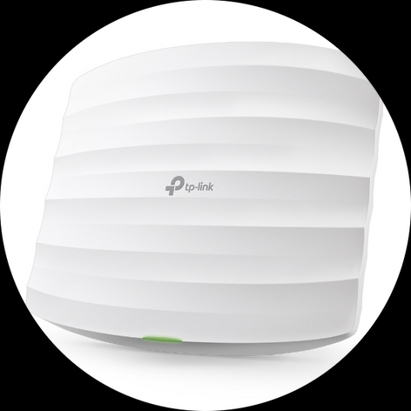

Signal Strength Analysis and Performance Testing Using Access Point and WirelessMon
In our project, the TP-Link Omada EAP110 model Access Point was used to measure the wireless network performance. This model is specifically designed for use in small to medium-sized offices, educational institutions, and similar environments.
The AP provides Power over Ethernet (PoE) support, allowing both power and data transmission to occur over a single Ethernet cable. Since we used only one computer in our project, we took advantage of this feature. With PoE, we were able to provide both data transmission and power to the Access Point using only one Ethernet cable, without needing a separate power source.
Using WirelessMon, we measured the signal strength levels at various locations in the Faculty of Fine Arts to identify areas with weak signal strength. The software displays the signal strength of each access point in percentage and dBm, allowing us to pinpoint weak signal areas. With a device connected to the Access Point, we observed the signal strength at specific points and marked areas where the signal strength dropped below 10%. These measurements showed that the signal strength rapidly declined as we moved further from the AP.

Slide 14
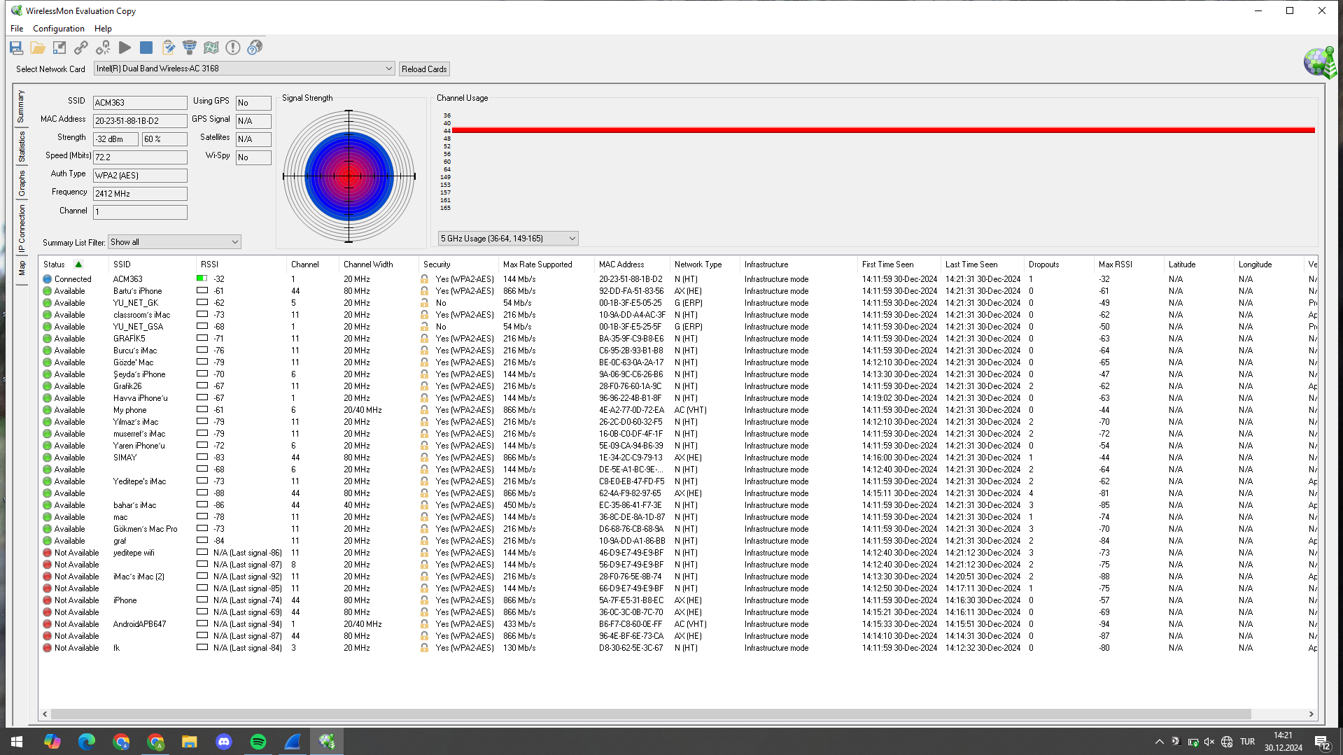
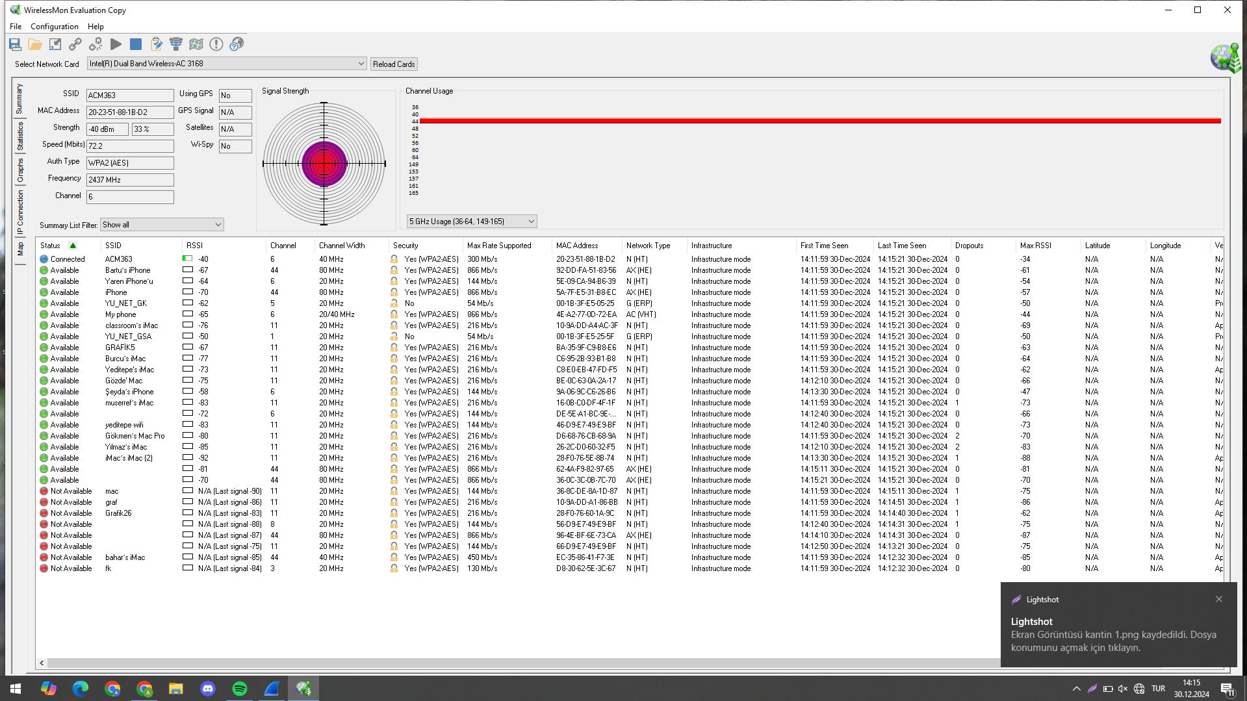
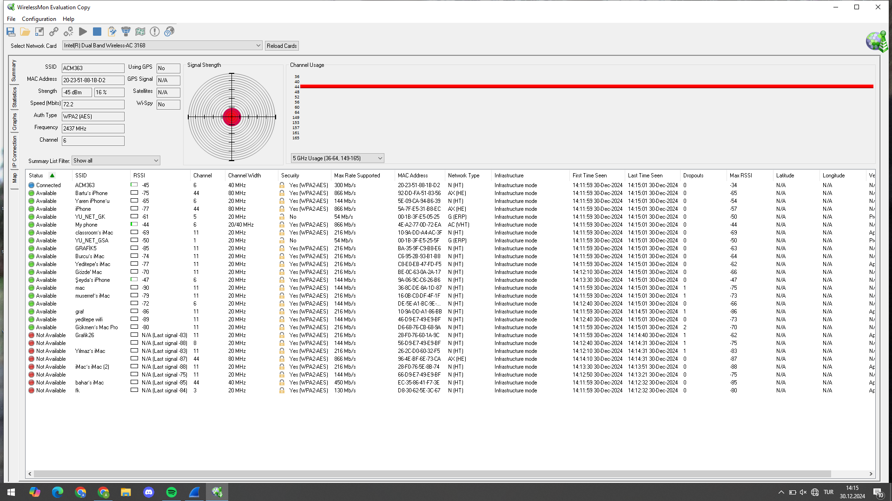
AP Signal Strength Measurements and Results
Distance (m) | Signal Strength (dBm)
0 (Next to AP) | -32 dBm
2-3 m | -40 dBm
5-6 m | -45 dBm
Measurement Next to the AP
Measurement Taken 2-3 Meters Away from the AP
Measurement Taken 5-6 Meters Away from the AP

Slide 15
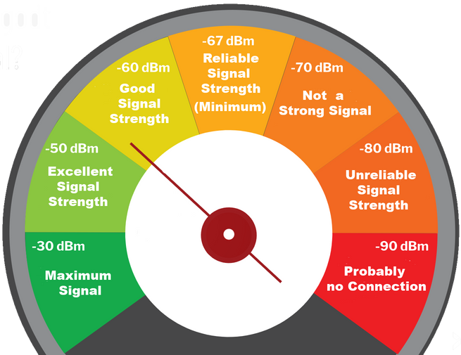
AP Signal Strength Measurements and Results
In our project, we used WirelessMon to measure the signal strength of the Access Point at different distances, and based on these data, we calculated the maximum range. According to the measurements, the signal strength next to the AP was -32 dBm, at 2-3 meters it was -40 dBm, and at 5-6 meters it was -45 dBm. The minimum signal strength we accepted for the signal to begin weakening was -67 dBm.
Using these measurements, we calculated the drop in signal strength. By observing the difference in signal strength between 0 meters and 6 meters, we found the signal drop rate to be -2.17 dBm/meter. Then, we calculated the distance over which the signal would lose strength from -32 dBm to -67 dBm, and we found this distance to be approximately 16.1 meters. This calculation shows that the Access Point's signal connection will remain healthy up to a distance of 16.1 meters.
Since we performed this measurement in an open area like the cafeteria, we used it to make a calculation for clear, unobstructed spaces. We concluded that placing an Access Point every 12 meters would be ideal to ensure effective signal strength and uninterrupted internet access.
We also conducted measurements in areas with obstacles and in less open spaces. In these areas, we tested how the signal strength changed to understand its behavior under such conditions.

Slide 16
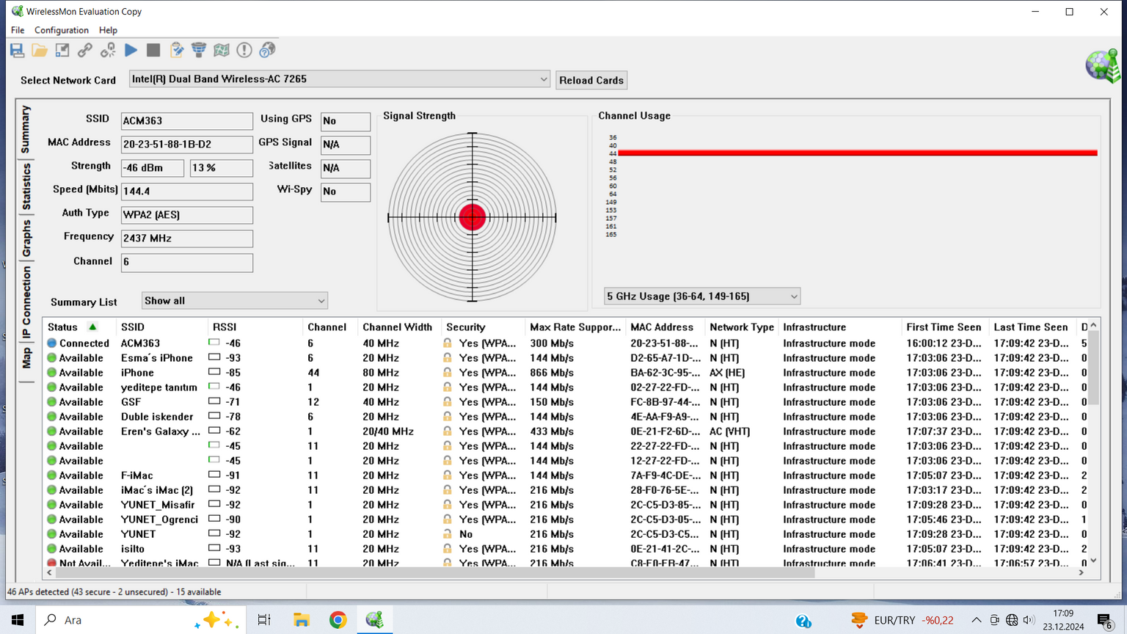
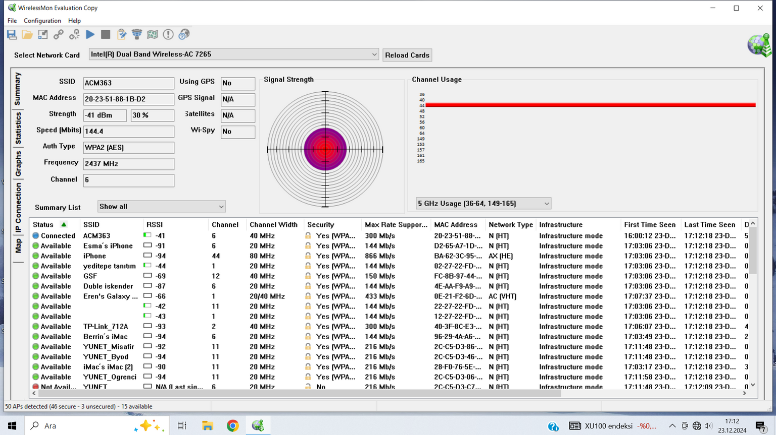
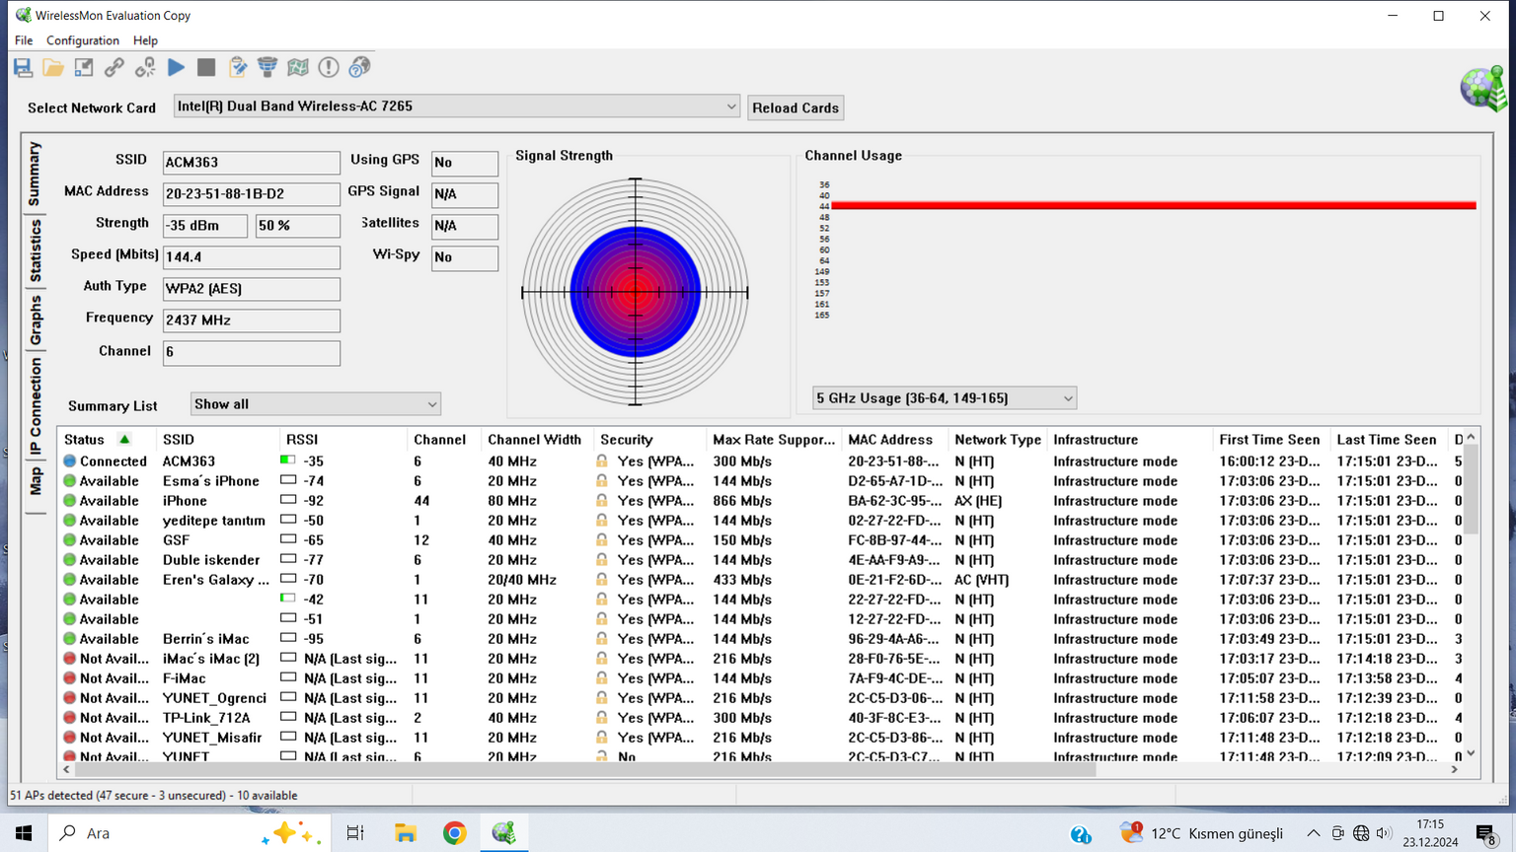
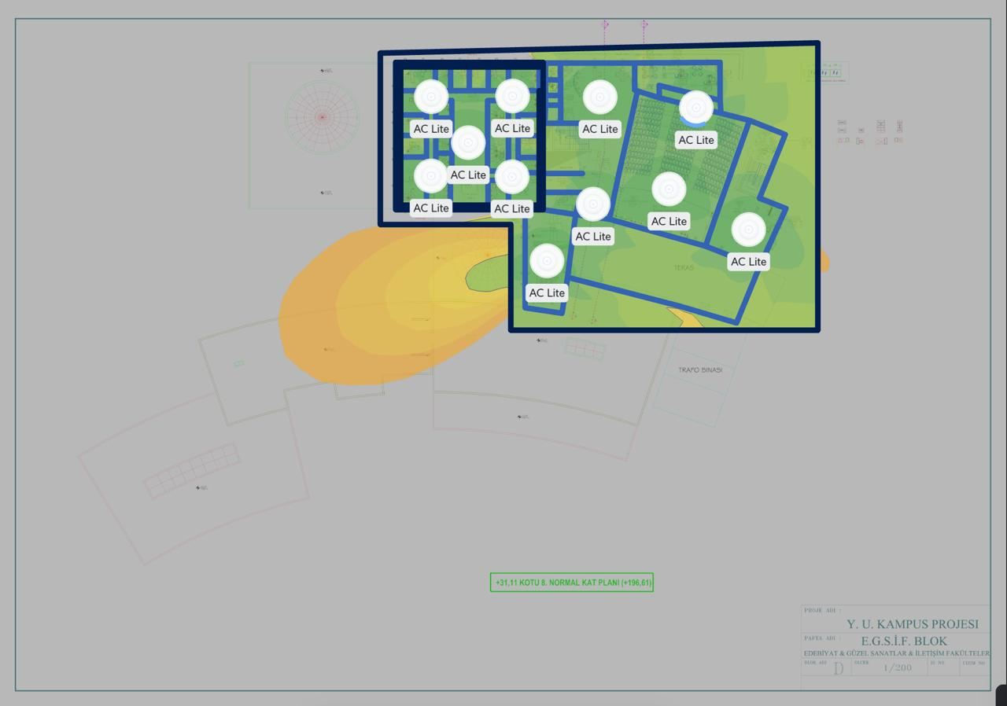
Conference Hall Measurements
Using WirelessMon, we measured the Wi-Fi signal strength provided by the Access Point (AP) installed in the conference hall to evaluate whether it ensured adequate coverage across the entire space.
Initially, a measurement was taken right next to the AP, and the signal strength was recorded as -35 dBm. Next, we moved toward the corners of the hall, where the signal strength measured -41 dBm. Finally, at one of the far corners of the hall, the signal strength was recorded as -45 dBm.
Based on these measurements, we determined that the AP's signal strength was sufficient to cover the entire conference hall. Since there were no large objects or physical obstacles that could obstruct the signal, the AP maintained strong coverage at every point in the hall. Additionally, we discovered that a pre-existing Wi-Fi network in the hall already provided full coverage, confirming its effectiveness.
The results of these measurements concluded that one APs were sufficient for the conference hall. Therefore, with the current Wi-Fi network and the AP’s signal strength, no additional hardware was deemed necessary.
8th Floor Conference Hall

Slide 17
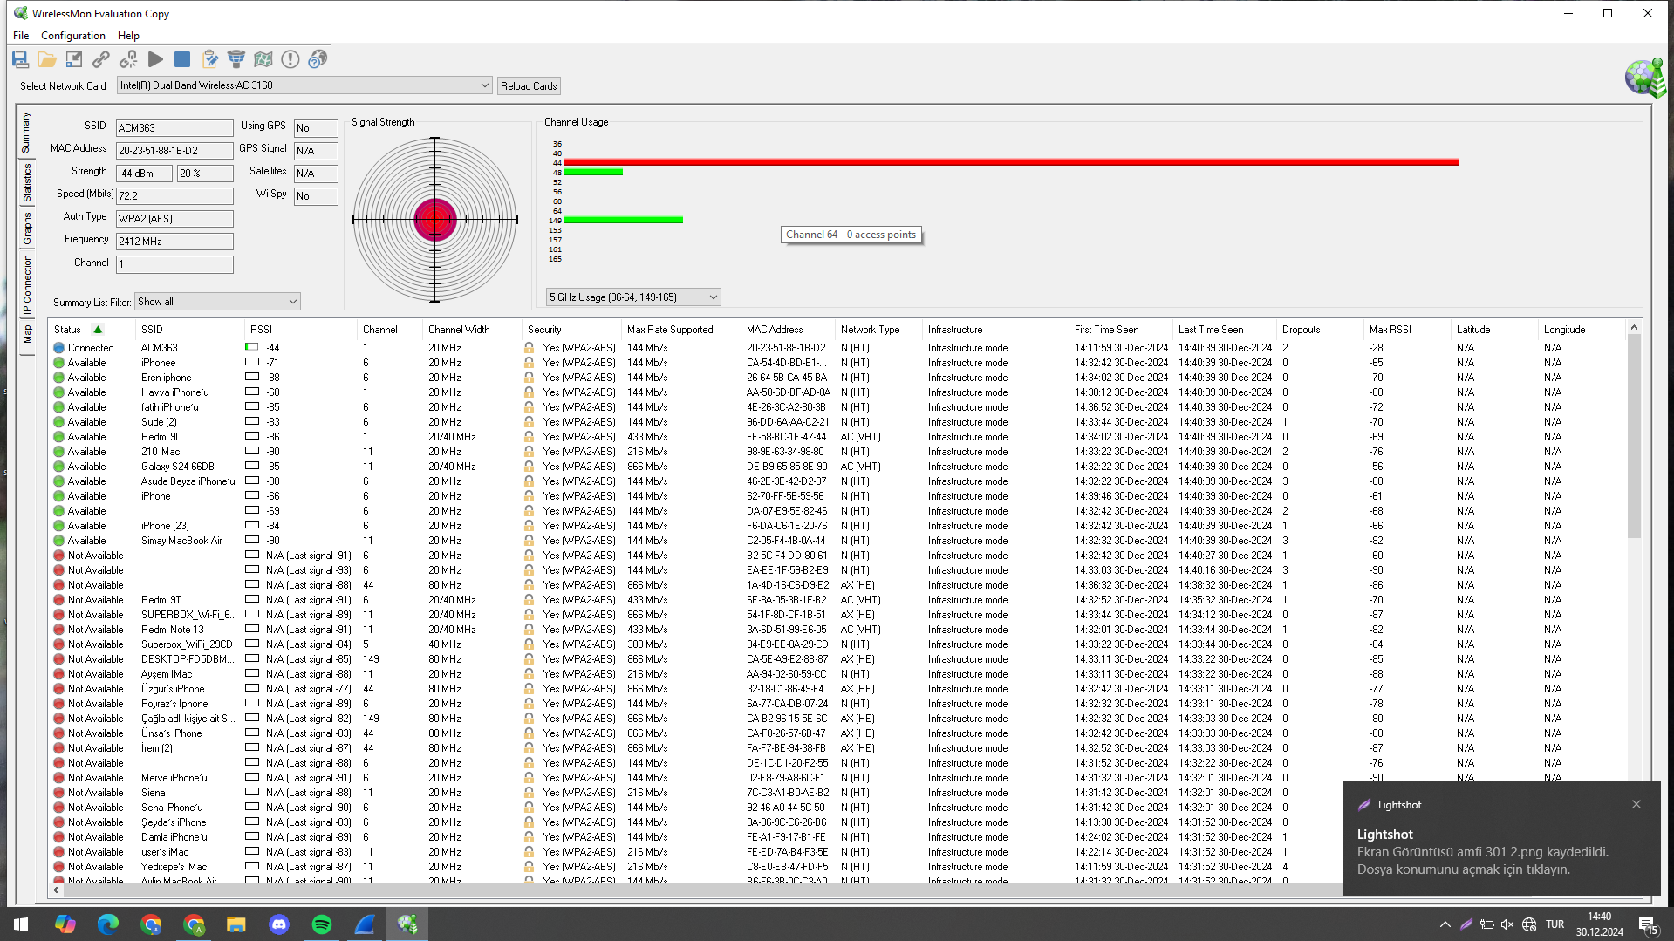
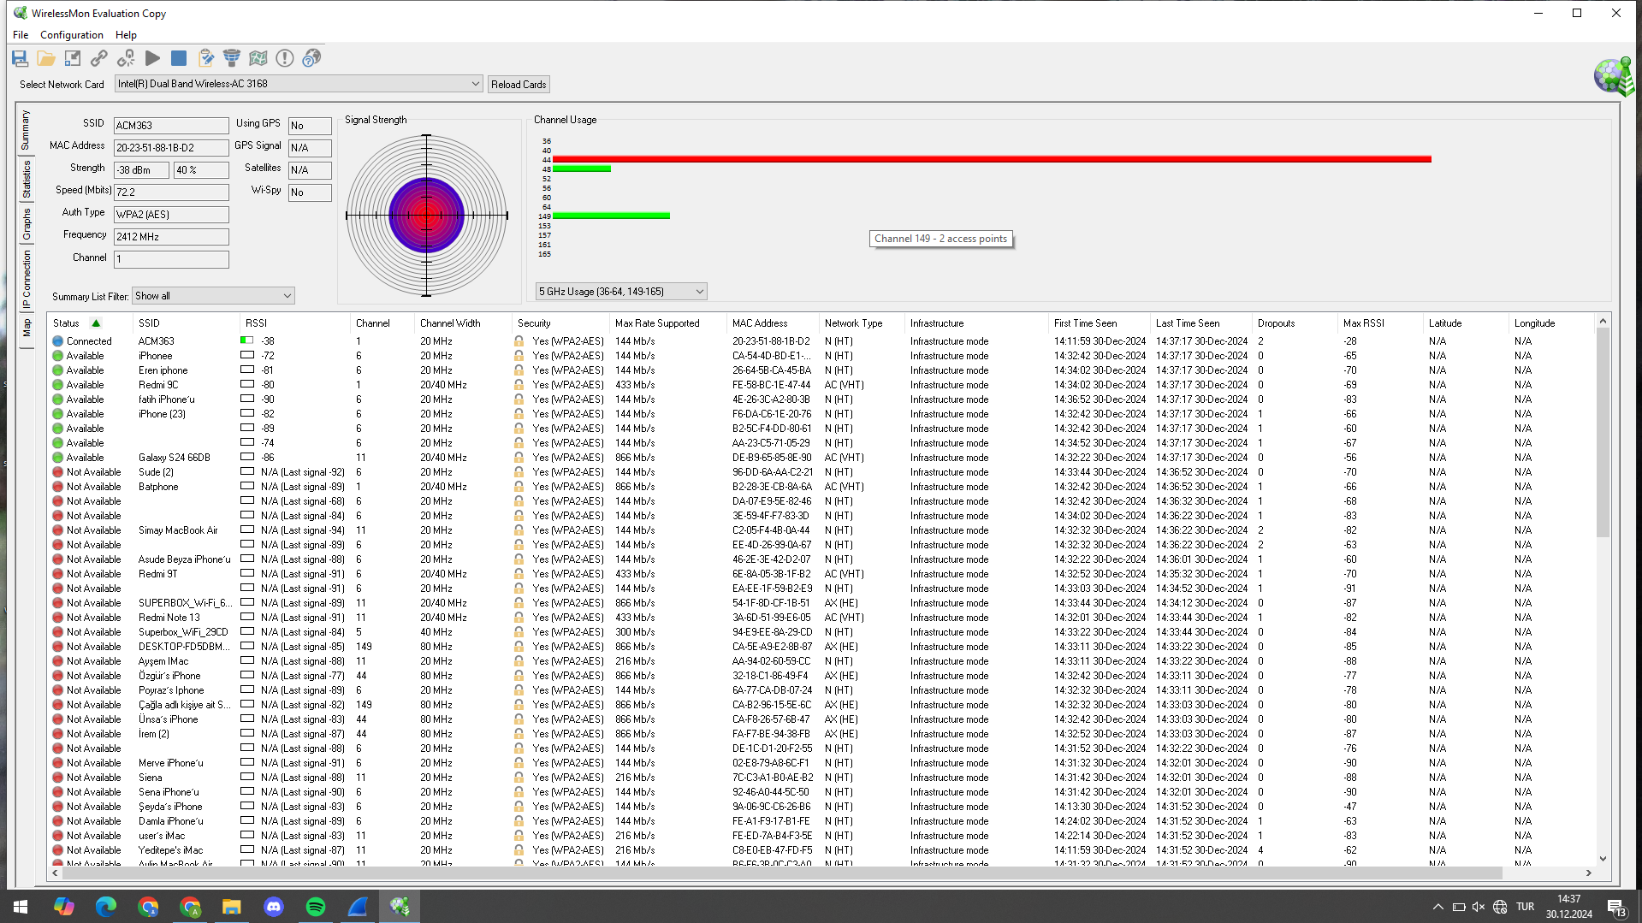
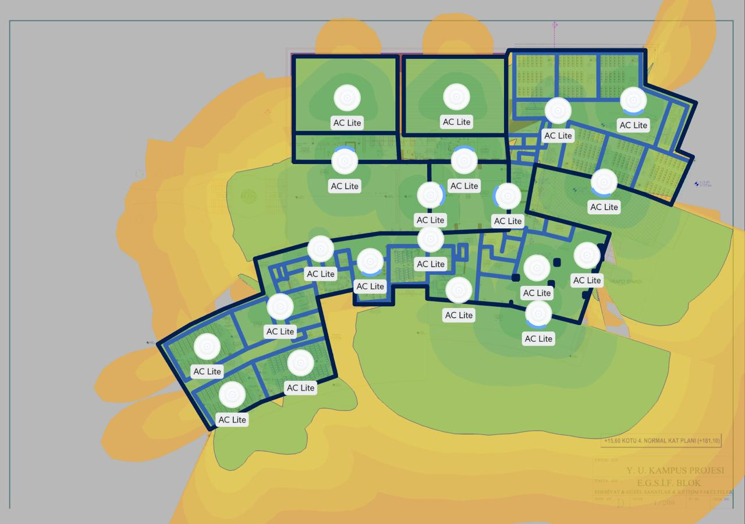
Lecture Hall Measurements
In the faculty's lecture halls, we measured the signal strength of the Access Point using WirelessMon to evaluate its coverage at different points.
The first measurement, conducted near the AP, recorded a signal strength of -38 dBm. Moving toward the corner of the lecture hall, a decrease in signal strength was observed, dropping to -44 dBm.
These results indicate that a single Access Point is sufficient to cover the entire lecture hall. Since there are no significant physical obstructions within the hall, the signal loss was minimal, making one AP suitable for each lecture hall.
4th Floor Lecture Halls

Slide 18
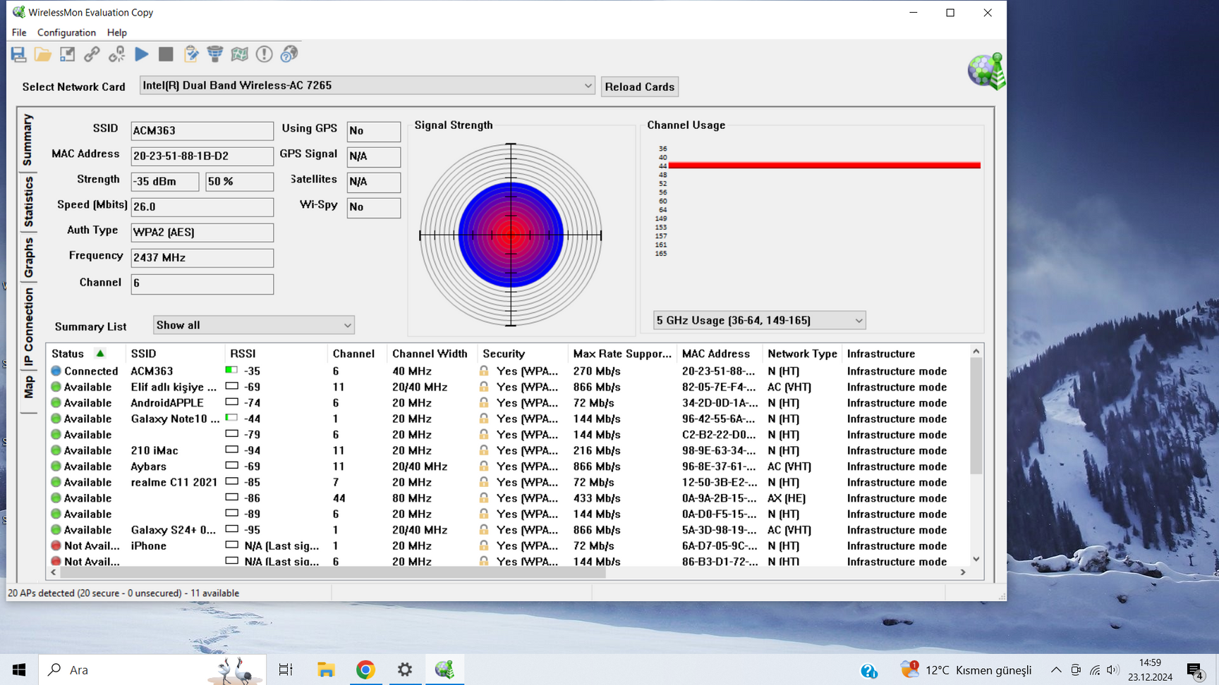
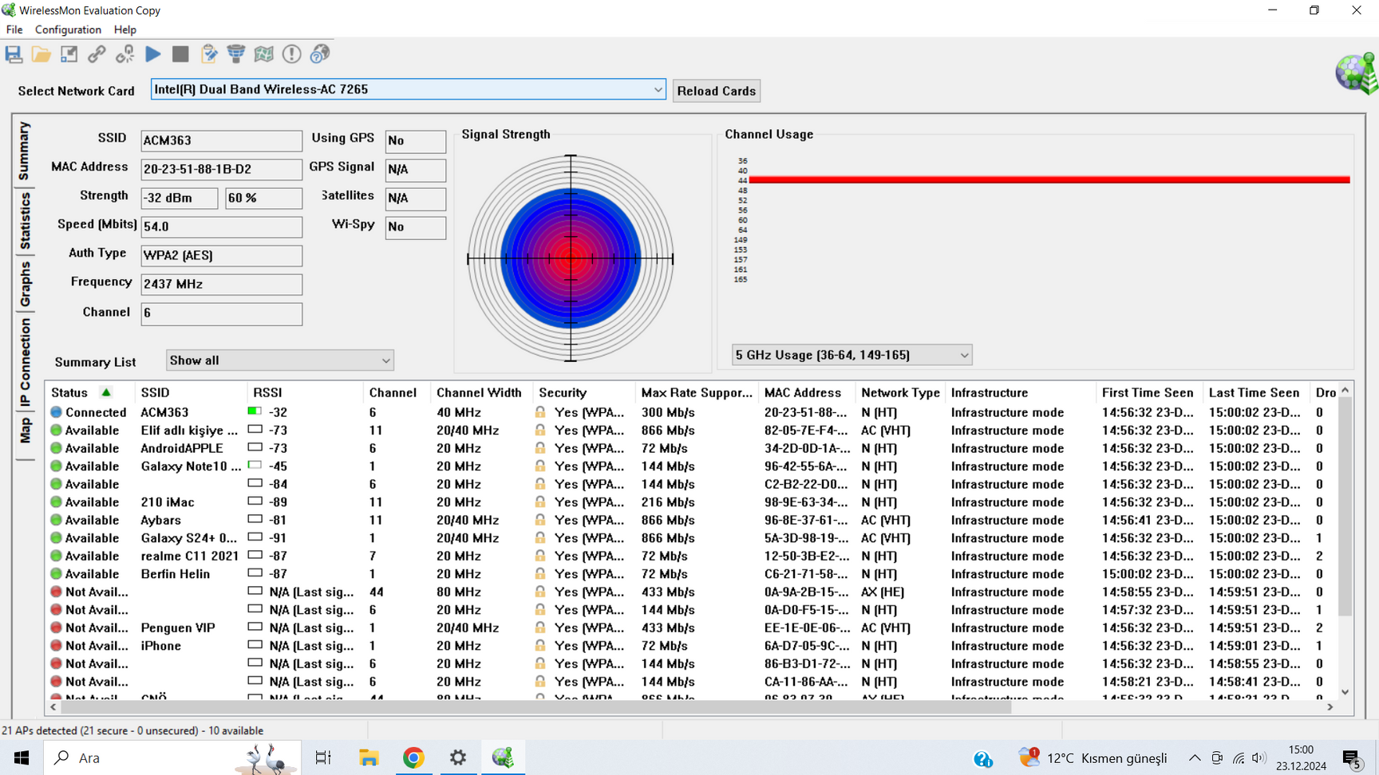
Classroom Measurements
In the measurements we conducted in the classrooms, when the Access Point was placed in the center of the room, the signal strength was measured at -32 dBm. As we moved toward the edges of the room, the signal strength decreased to -35 dBm. Based on these results, we concluded that it is not necessary to place a separate Access Point in each classroom. Instead, we placed 3 Access Points for 6 classrooms.
4th Floor Classrooms

Slide 19
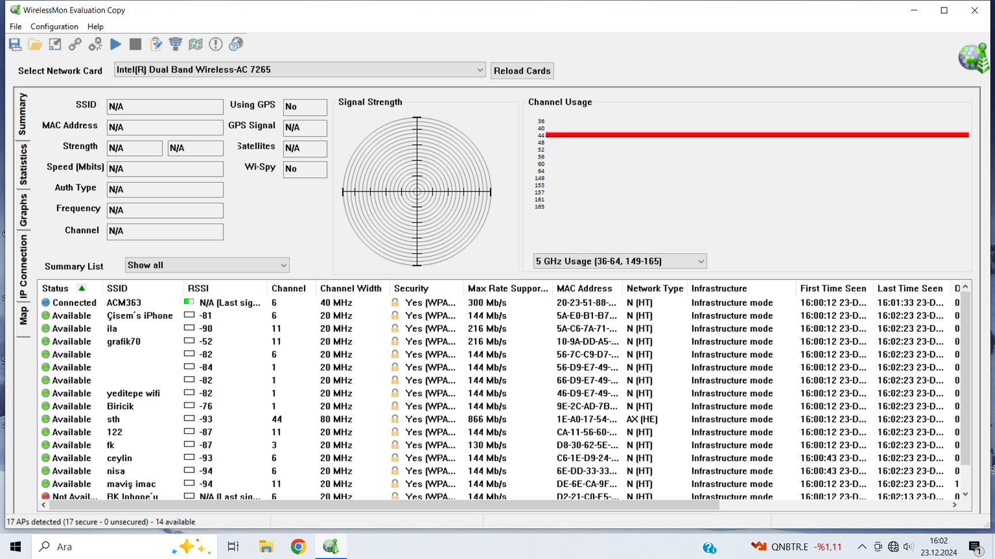
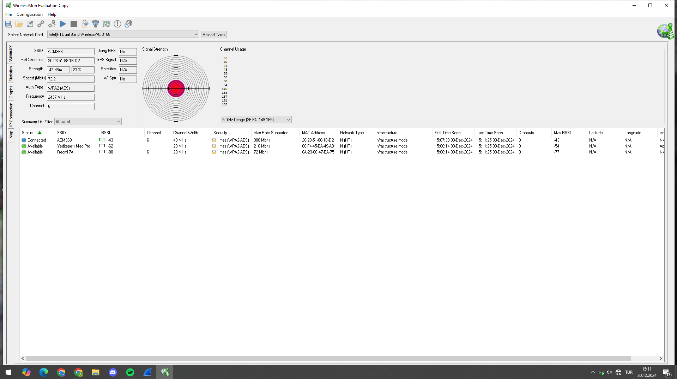
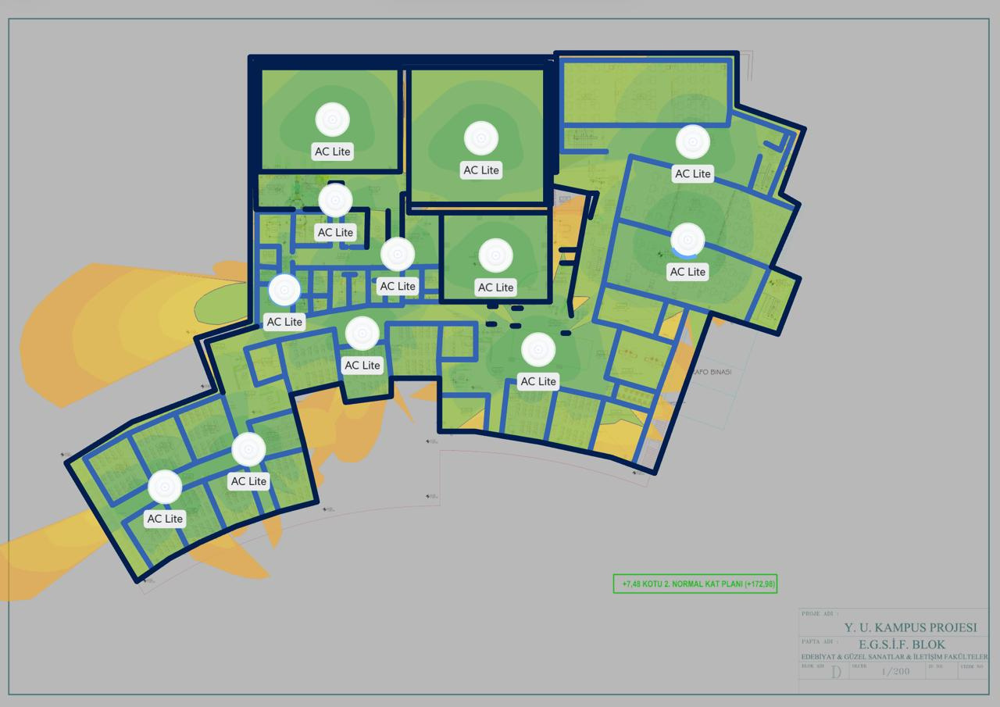
Studio Measurements
In the measurements conducted in the studios of the faculty, we observed a drop in signal strength due to the thick walls of the studios, which made it difficult for the signal to pass through. This issue was particularly noticeable as the signal quality rapidly decreased when moving toward the interior of the studios. Since signal loss occurred in every studio we measured, we concluded that in order to provide uninterrupted internet access in these areas, an Access Point should be placed in each studio.
2nd Floor Studios

Slide 20
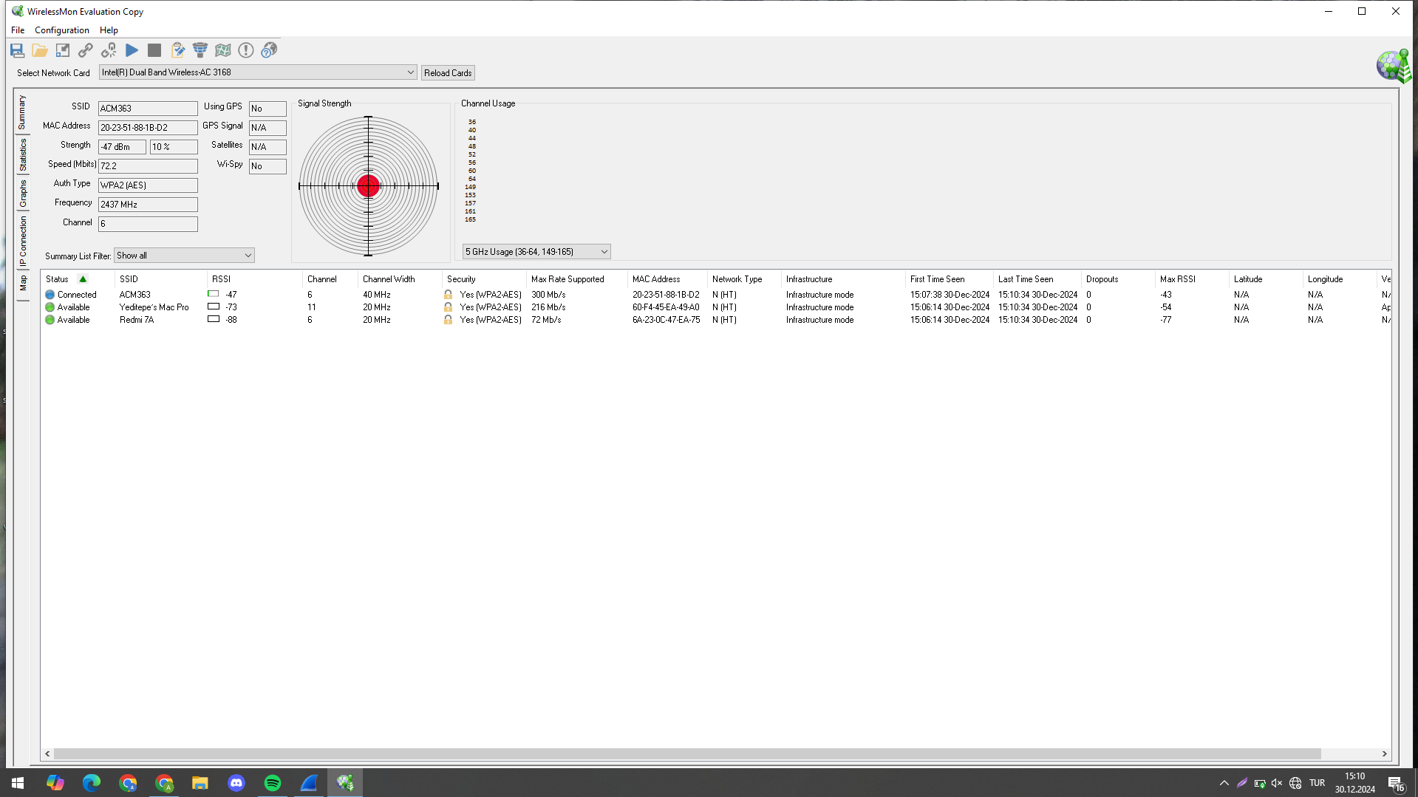
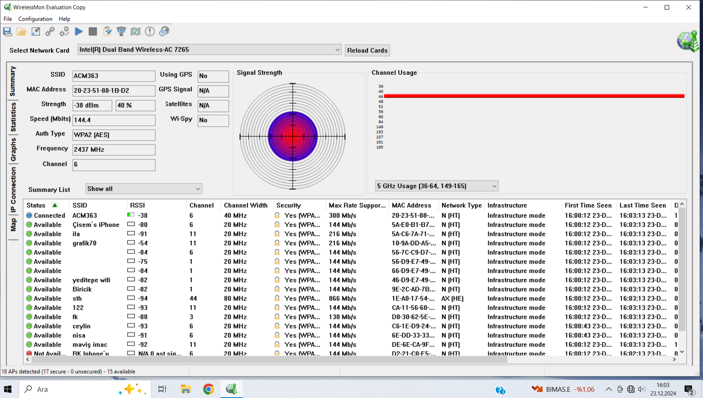
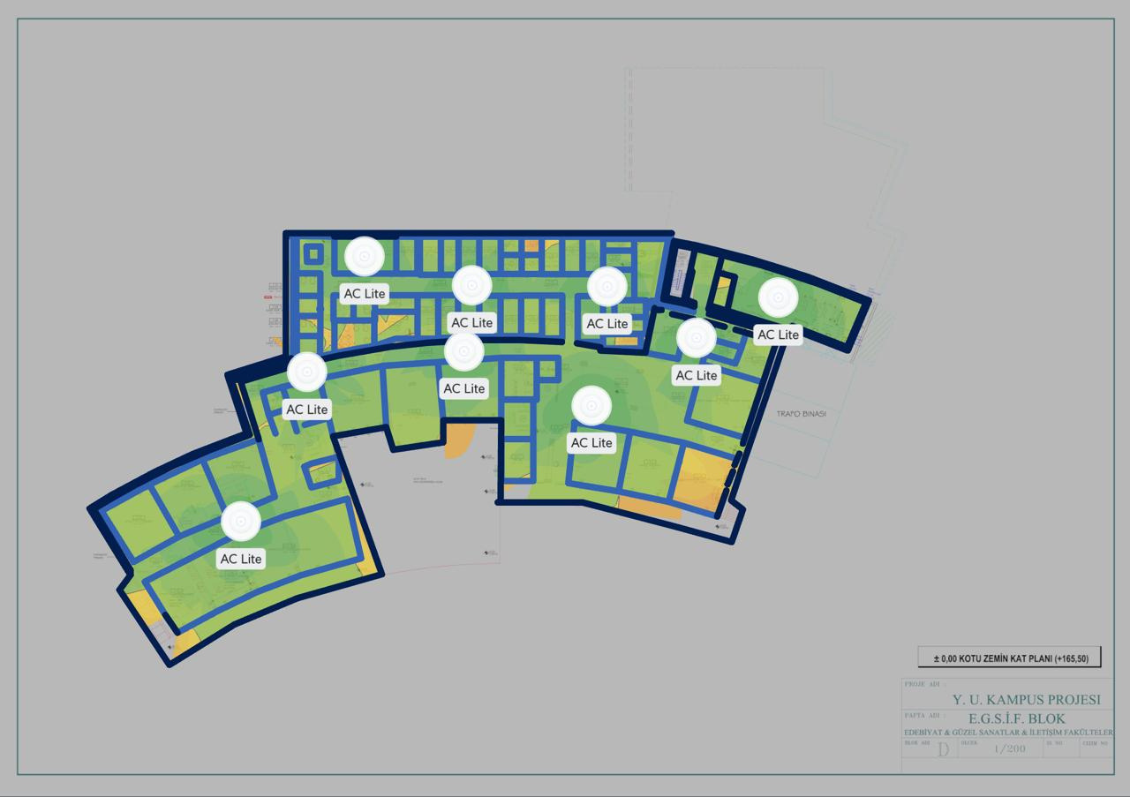
Gallery Area Measurements
In the measurements conducted in the gallery area on the ground floor, we placed the Access Point at the center of the gallery and tested the signal strength at different distances. The measurement close to the AP showed a signal strength of -38 dBm, while when we moved further into the gallery, the signal strength dropped to -47 dBm.
We noticed that the pictures, decorative items, and other objects in the gallery area partially obstructed the signal transmission. However, it was observed that these obstacles did not cause a complete loss of signal strength. Based on the tests, we determined that the signal was strong enough to cover the entire gallery area.
Based on these measurements, we concluded that one AP would be sufficient in the gallery, and uninterrupted connectivity could be provided throughout the space. Strategically placing the AP at the center during installation will ensure that the signal is evenly distributed across the entire area.
Ground Floor Galllery

Slide 21
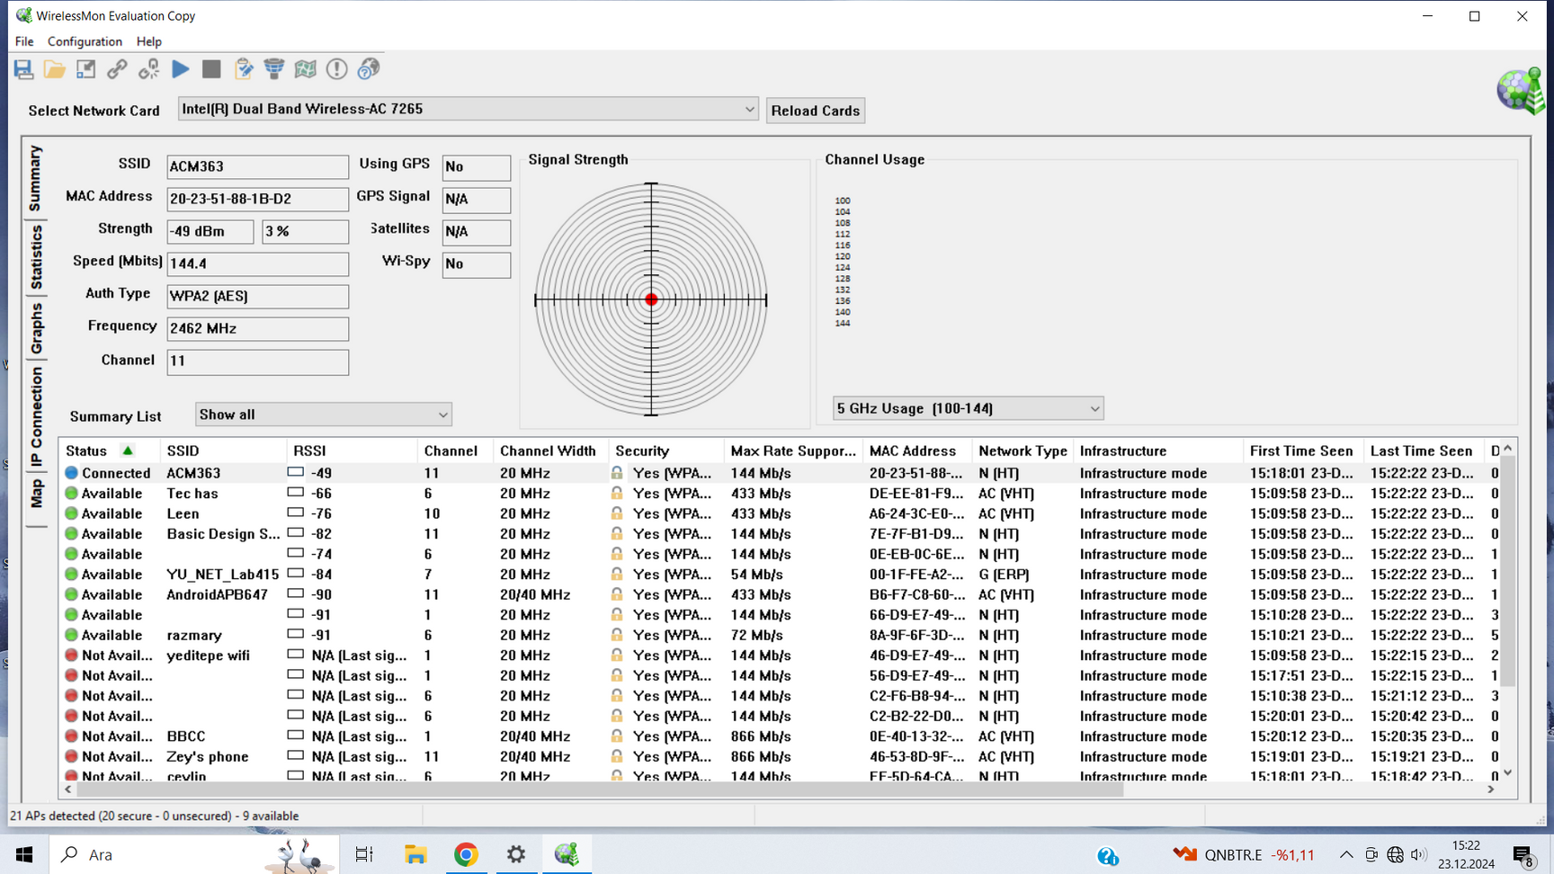
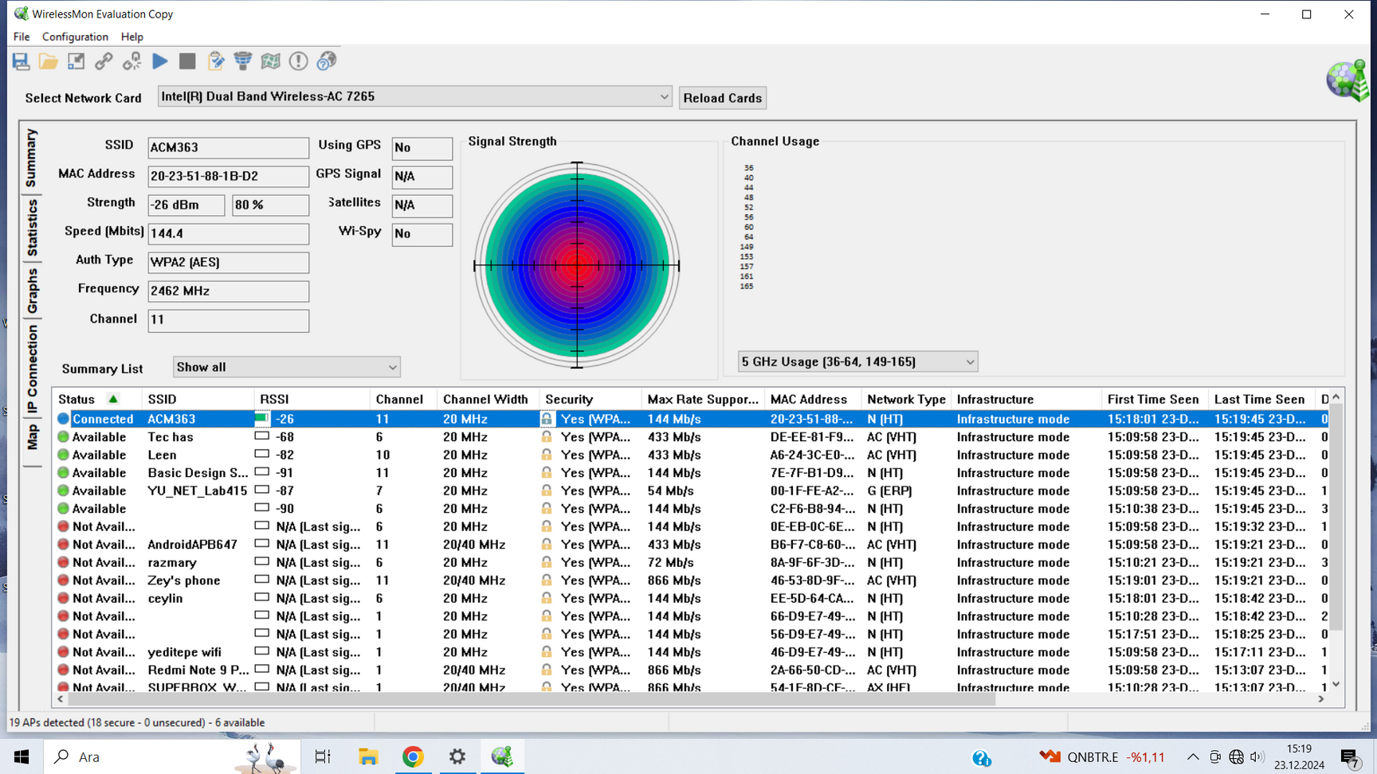
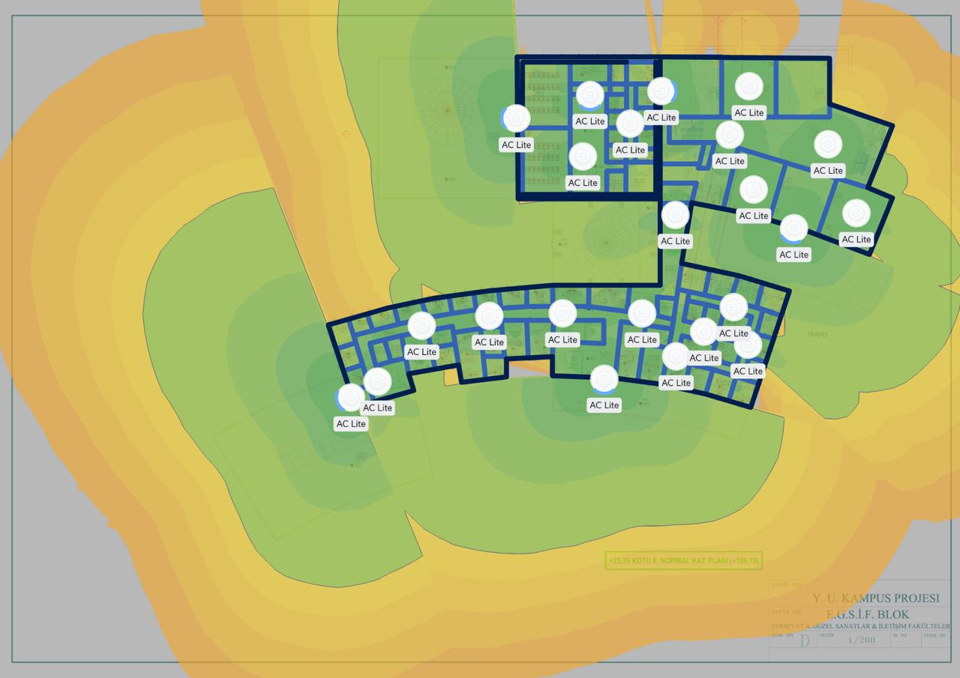
Corridor Measurements
In the measurements we conducted in the corridors, the Access Point provided a strong signal throughout the corridor. We observed that the signal strength was quite high at various points along the corridor. However, when we entered the nearby rooms, we noticed a significant drop in signal strength. This indicates that the thick walls in the faculty are negatively affecting the signal transmission.
According to the measurement results, the signal strength started at a high value of -26 dBm along the corridor, but it dropped to -49 dBm in the nearby rooms. The walls, in particular, caused signal loss, preventing the signal quality from reaching the desired level in the rooms. To ensure good signal coverage in the rooms as well, we strategically placed the APs in the corridors.

Slide 22
Floor Plans
To visualize the Access Point placement on floor plans and optimize signal quality, we used an application called Unify GPT. This application helped us predict where we could receive good signal by inputting the AP's specifications into the system. Thanks to this application, we virtually placed the APs on the faculty's floor plans and analyzed the signal distribution.
On the map provided by the application, green areas represent good and very good signal levels, while orange areas indicate that the signal strength has dropped to an average level. The walls shown in dark blue are simulated as thick walls. These walls block the signal and cause power loss, so we were careful when placing the APs.
During the placement process, we strategically placed the APs in key locations to achieve good signal coverage everywhere. However, we also realized that this solution might not be the most cost-effective method. Since the TP-Link Omada EAP110 model we used offered limited performance in terms of signal strength and coverage, we needed to install more APs across the faculty to ensure strong signals everywhere. If a more powerful AP model is chosen, wider coverage can be achieved with fewer APs across the faculty, optimizing costs.
9 AP
GROUND FLOOR

Slide 23
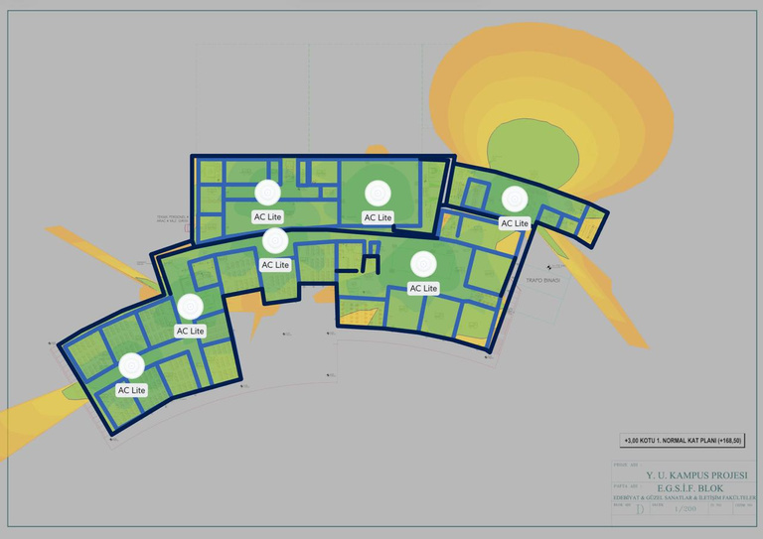
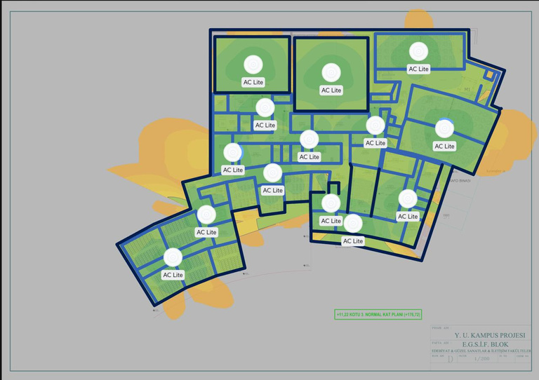
Floor Plans
6 AP
12AP
1ST FLOOR
3RD FLOOR
11AP
20AP
2ND FLOOR
4TH FLOOR

Slide 24
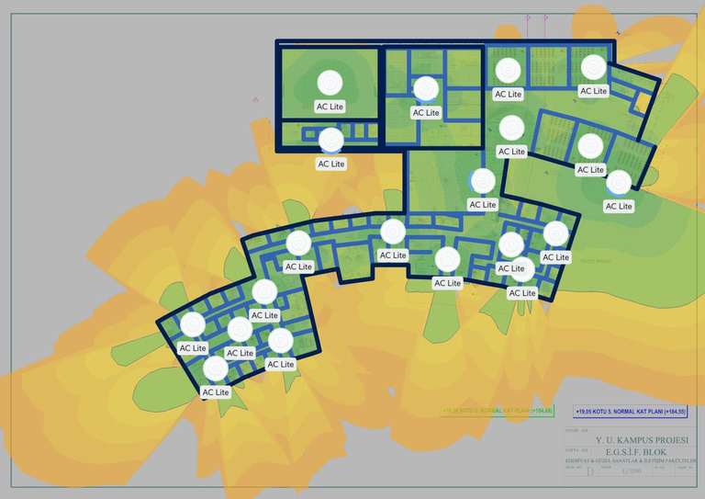
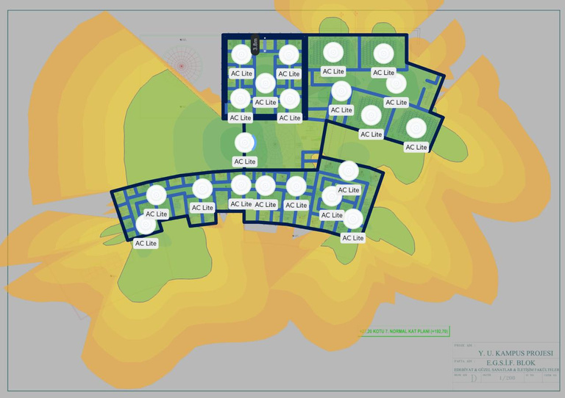
Floor Plans
18AP
20AP
5TH FLOOR
7TH FLOOR
23AP
11AP
6TH FLOOR
8TH FLOOR

Slide 25
Conclusion
In our project, we deployed a total of 130 Access Points to establish a robust and seamless wireless network across a large area. The setup process involved carefully considering factors such as the size of the area, user density, and optimal signal strength to develop the most efficient network design.
As a result, this project successfully enhanced the existing network infrastructure, ensuring reliable connectivity across all spaces. Additionally, the network was designed with future scalability in mind, allowing it to meet evolving demands and technological advancements.

Slide 26
Thank
You.
Thank
You.
Thank
You.

